Slide 1
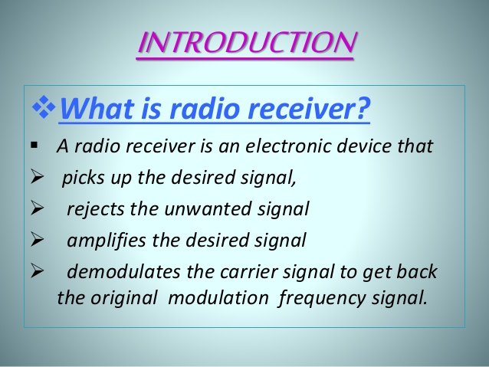

Slide 2
RADIO RECEIVERS
AM RECEIVERS
FM RECEIVERS

Slide 3
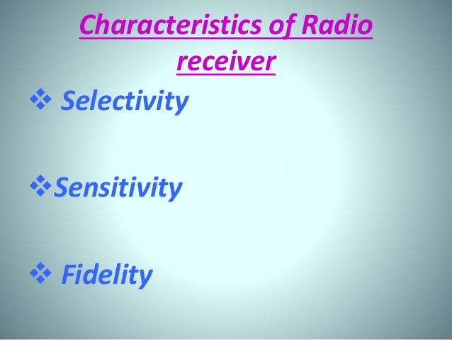

Slide 4
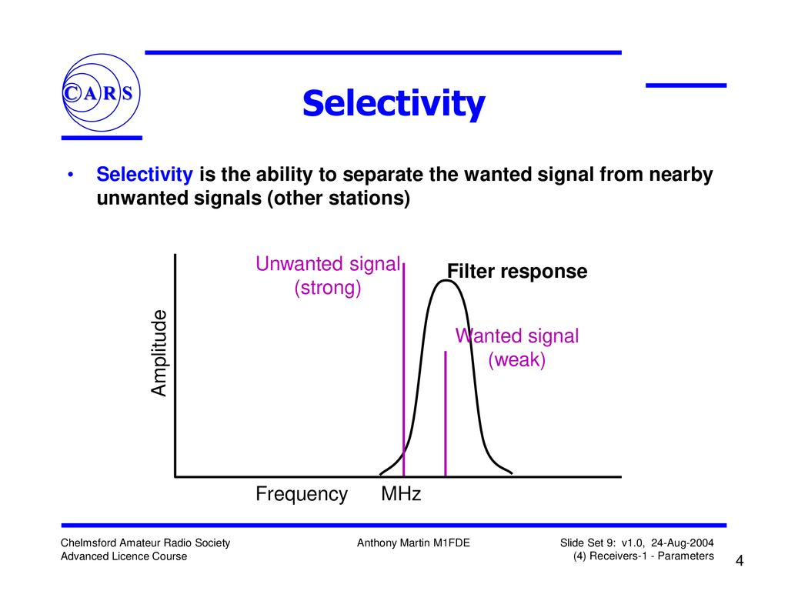

Slide 5
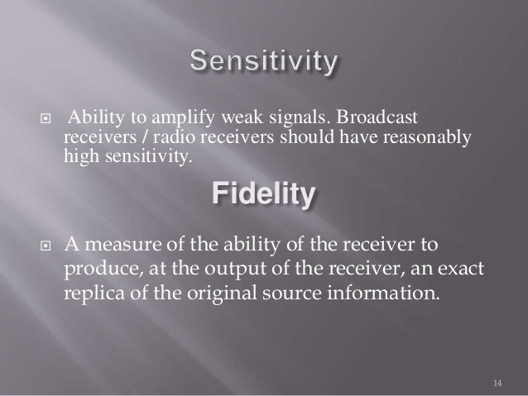

Slide 6
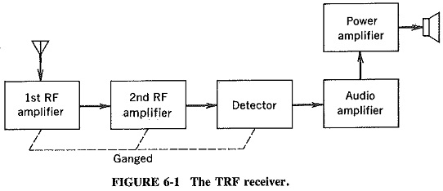
AM RECEIVERS
TUNED RADIO FREQUENCY RECEIVER
SUPER HETERODYNE RECEIVER

Slide 7
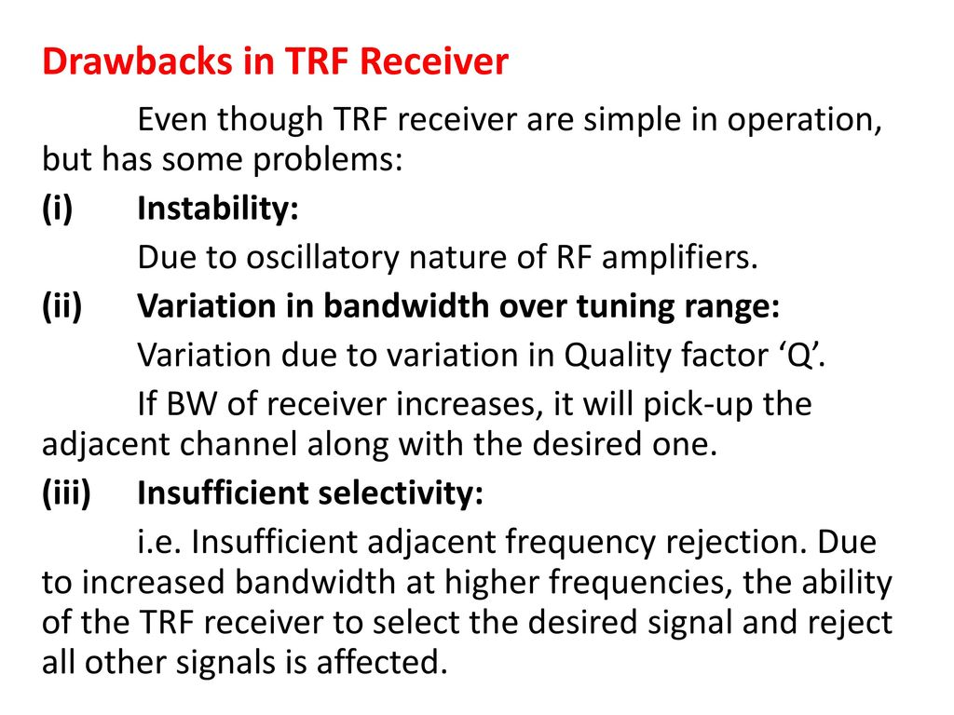

Slide 8
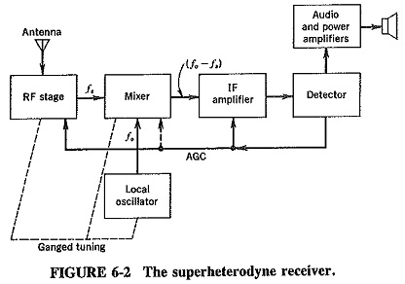
Super Heterodyne receiver :

Slide 9
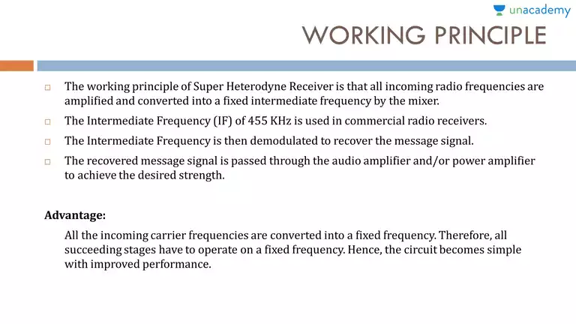

Slide 10
Advantages of RF amplifier:
Greater gain i.e. better sensitivity.
Improved signal to noise ratio.
Improved rejection of adjacent unwanted channel i.e. better selectivity.
Improved image frequency rejection.
Better coupling to antenna.

Slide 11
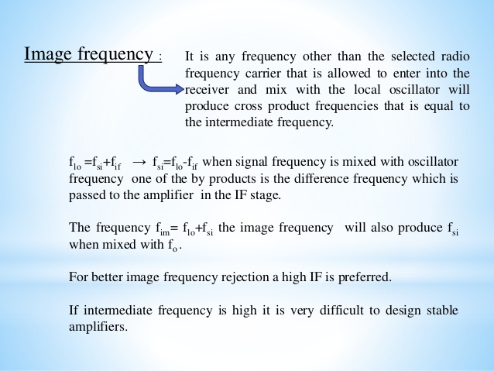

Slide 12
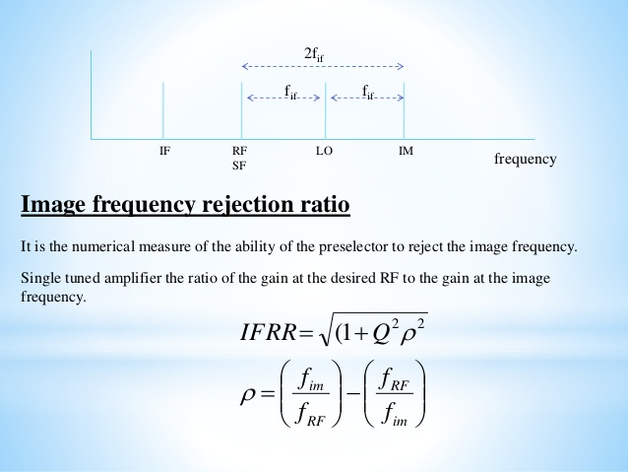

Slide 13
Local Oscillator :
Most commonly used local oscillators for AM broadcast receivers are Armstrong, Hartley , Clapp and Colpitts.
Colpitts and Clapp oscillators are used for higher frequency receivers.
All local oscillators are L-C oscillators and use a single tuned circuit.
Local oscillator frequency of the standard broadcast receiver is usually made higher than the incoming signal frequency by an amount equal to intermediate frequency (IF) of 455khz.

Slide 14
Local Oscillator :
Let local oscillator frequency is made smaller than the incoming signal frequency
In such case, the local oscillator should be capable of varying frequency in the range of 85khz to 1195khz.
This range gives a maximum to minimum frequency equal to 14:1. However , this ratio cannot be achieved by normal tunable capacitance.
The Capacitance of normal tunable capacitors may be varied in the ratio of maximum to minimum capacitance equal to 10:1 which gives a maximum frequency ratio of 3.2:1.
This means that if the local oscillator frequency is kept lower than the signal frequency by an amount of 455khz, the normal tunable capacitors cannot be used.

Slide 15
Local Oscillator:
If the local oscillator frequency is made larger than the incoming signal frequency amount by 455khz then the variation of capacitance over the complete AM band would be from 995khz to 2105khz which gives a ratio of 2.2:1.
This ratio can be easily achieved by using normal tunable capacitor.
Thus, due to this reason , the super heterodyne receivers used for commercial broadcasting use local oscillator frequency which is higher than signal frequency.

Slide 16
Mixer:
A Frequency mixer is a non linear device which produces a number of frequencies when two different frequencies are applied at the input of a mixer.
Out of all these frequencies, one of the interest is the component of difference frequency(f0-fs).
This component is selected at the mixer output by a tuned circuit which is tuned to this difference frequency term.
This difference frequency term (f0-fs) is called Intermediate Frequency.
Generally mixers are classified into two categories as self excited and separately excited mixers.
In self excited mixer, the same device acts as an oscillator as well as mixer whereas in the separately excited mixer, two devices are used, one each for the mixer and oscillator.

Slide 17
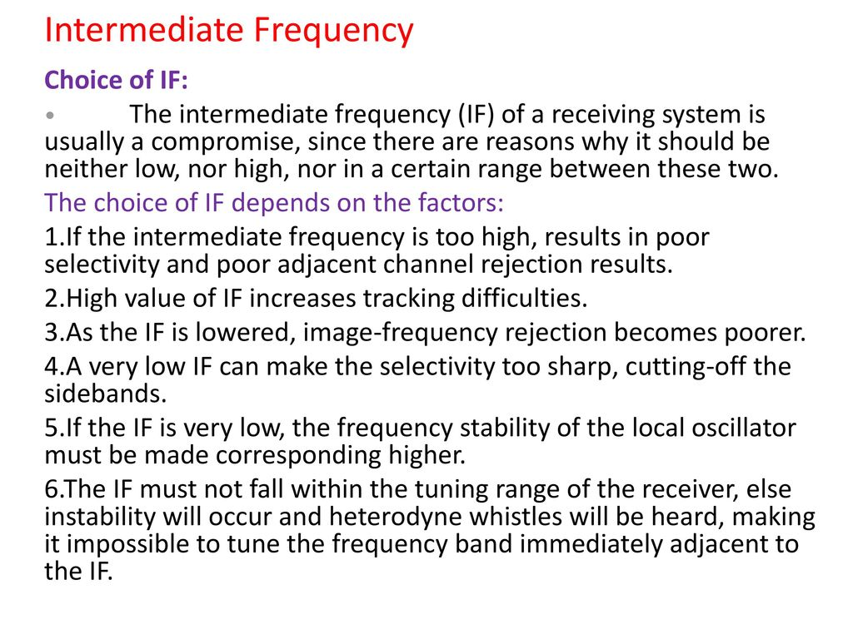

Slide 18
Tracking:
The receiver has a number of tunable circuits such as the antenna, RF stage, mixer , Local oscillator.
All these circuits must be tuned correctly if any station is to be tuned.
For this reason , the capacitors in the various tuned circuits are ganged (mechanically coupled to each other) .
Due to this arrangement, it is possible to use only one tuning control capacitors simultaneously.
The local oscillator frequency (f0) must be precisely adjusted to a value which is above the signal frequency(fs) by IF i.e. f0= fs + IF.
If this tuning is not done precisely then the frequency difference i.e. (f0-fs) is not correct.

Slide 19
Tracking:
This type errors are known as the tracking errors because tracking is a process in which the local oscillator frequency follows or tracks the signal frequency to have a correct frequency difference.
Due to tracking errors , the stations appear away from their correct position on the frequency dial of the receiver.
The acceptable tracking error is +/-3KHZ

Slide 20
IF Amplifier :
The stages of an intermediate frequency amplifier ("IF amplifier“) are tuned to a fixed frequency that does not change as the receiving frequency changes.
The IF amplifier is selective around its center frequency f_{IF}.
The fixed center frequency allows the stages of the IF amplifier to be carefully tuned for best performance (this tuning is called "aligning" the IF amplifier).
Every stage of IF Amplifier provides a high gain, due to this there is a tendency of oscillations in the circuit.

Slide 21
AGC :
A circuit to adjust the gain of a system in accordance with the input signal strength is Automatic gain control (AGC).
It derives a dc voltage proportional to carrier amplitude from a detector.
It provides that dc voltage as a negative feedback to RF stage, mixer and IF amplifiers.
If carrier signal amplitude increases , the AGC bias increases and the gain of all the tuned stages decreases.

Slide 22
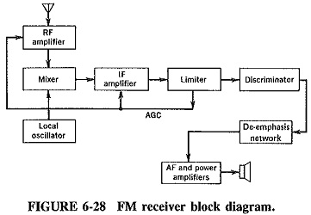
FM Receiver :

Slide 23
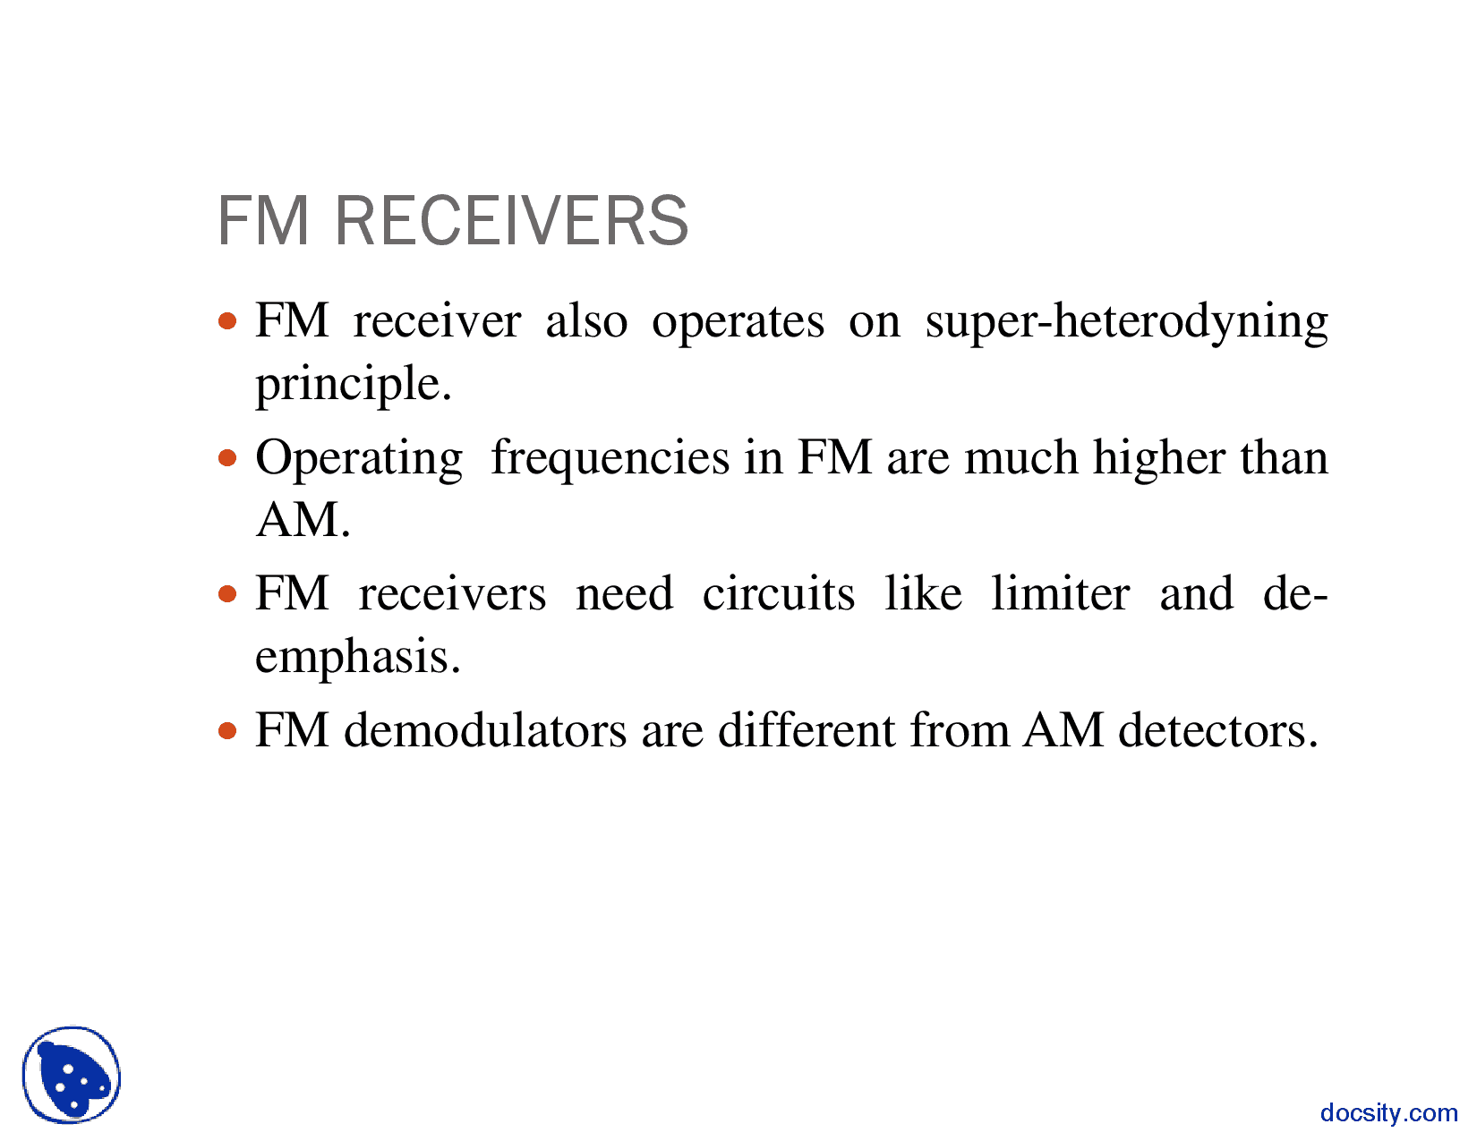


Slide 24
FM Receivers:
FM Operating range is 88MHz to 108 MHz
FM IF frequency is 10.7MHz
FM Bandwidth is 200KHz
Standard Deviation is 75kHz

Slide 25
Amplitude Limiter:
When an FM wave is transmitted through a communication channel , in general, output will not have a constant amplitude because of channel imperfections.
At the receiver, it is essential to remove the amplitude fluctuations in the channel output prior to frequency demodulation.
This is done by means of an Amplitude limiter.
Since most of the FM demodulators react to amplitude changes as well as frequency changes.
A limiter is a form of clipping device, a circuit whose output tends to remain constant despite changes in the input signal.

Slide 26
AM Receiver VS FM Receiver :
AM Receiver
FM Receiver
AM Broadcast range
540KHz to 1640KHz
IF frequency – 455KHZ
Bandwidth- 10KHz
RF amplifier is optional
Limiter and de-emphasis are not required.
Noise is more as information is transmitted in amplitude variations.(Poor quality).
Cheaper in cost
FM Broadcast range
88MHz to 108MHz
IF frequency- 10.7MHz
Bandwidth – 200KHz
RF amplifier is mandatory.
Limiter and de-emphasis are required.
Less noise as information is transmitted in frequency variations.(Good quality).
Costlier.

Slide 27
AM Transmitters (Low level) :
Amplitude Modulated (AM) transmitter, Fig gives the block diagram of amplitude modulated radio transmitter.
It consists of two sections (i) Audio frequency (AF) section and (ii) Radio frequency (RF) section. AF section
The AF section of the transmitter generates the modulating wave (signal). The conversion of sound energy into electrical energy is performed by the microphone.
The electrical energy available from the microphone is very low. Hence, it is amplified through an amplifier.
The output from the AF amplifier if fed to the AF power amplifier. The power amplifier provides the required audio frequency power. The output of the AF power amplifier is given to the modulator.
A modulator is an electronic circuit with transistor, and passive components, which performs the process of modulation.

Slide 28
AM Transmitters :
In the RF section, the high-frequency carrier wave is generated by a crystal controlled oscillator.
The output of the crystal controlled oscillator is power amplified by RF power amplifier.
The buffer isolates the RF power amplifier from the oscillator. This arrangement keeps the frequency of the crystal controlled oscillator as a constant.
In the modulator, the RF wave and modulating AF signal are mixed to produce the amplitude modulated wave. The output of this section is fed to the antenna for transmission.

Slide 29
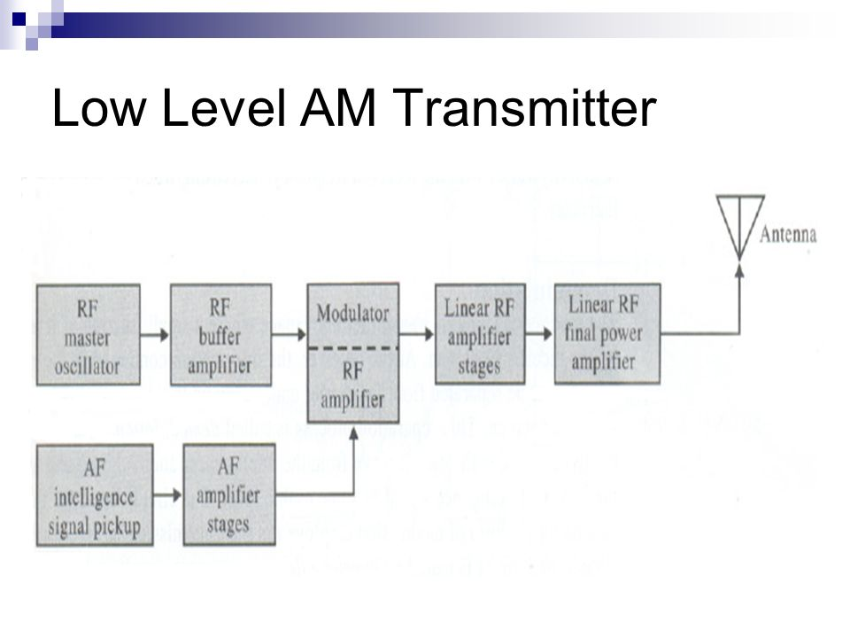

Slide 30
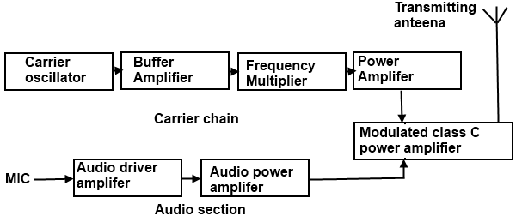
High Level AM Transmitter :

Slide 31
